Slide 1

BMS COLLEGE OF ENGINEERING
Department of Electronics & Telecommunication Engineering
Course Title : IoT & Wireless Sensor Network Course Code : 19ET6PE31T Project Title : Smart Street Light System By : Roopashree V ( 1BM20ET403 ) Suparna NK ( 1BM20ET402 ) Sinchna CS ( 1BM19ET056 )

Slide 2
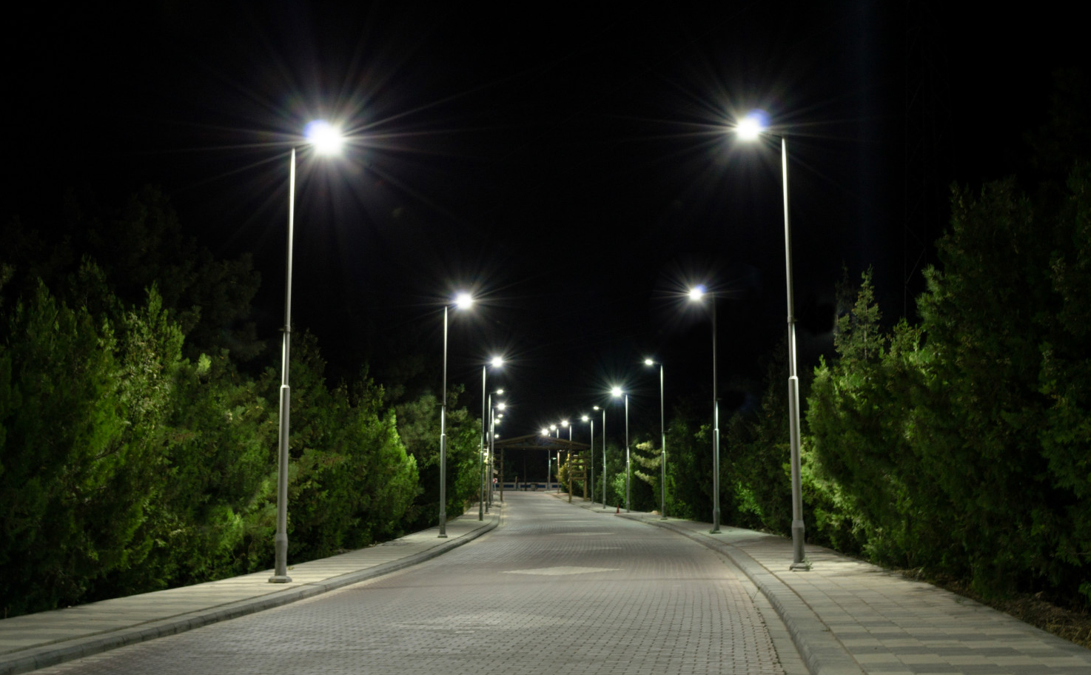
CONTENTS
INTRODUCTION
HOW IT WORKS
MAIN COMPONENTS
CIRCUIT DIAGRAM
ADVANTAGES
DISADVANTAGES
APPLICATION
CONCLUSION
REFERENCES

Slide 3
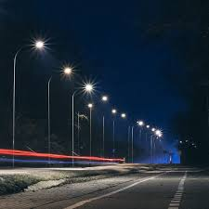
INTRODUCTION
A smart street light is a public lighting system that incorporates technology, LDR, and other sensors, to introduce real-time monitoring functionalities.

Slide 4
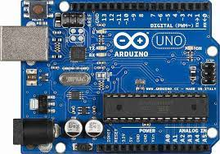
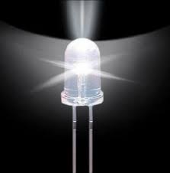
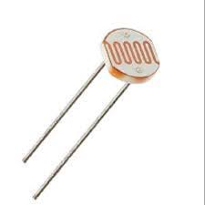
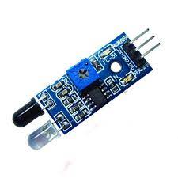
COMPONENTS
Arduino uno
Bread board
IR sensors
LDR
LEDs
Resistors

Slide 5
WORKING
This concept involves a smart street light that turns on during the night time as a vehicle and people pass by it.
LDR is used to detect the presence of light, in the presence of light all the LEDs will be off.
Here, we are employing 5 IR sensors, each of which controls 5 LEDs.
When a certain IR sensor detects the presence of a vehicle or people, and it is dark it notifies the Arduino board and activates the LEDs.

Slide 6
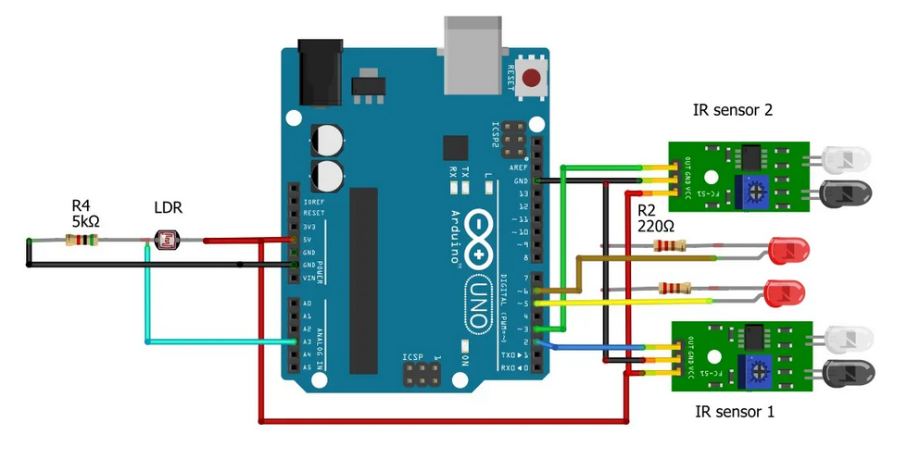
CIRCUIT DIAGRAM

Slide 7
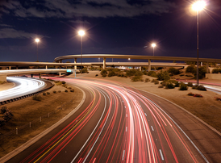
ADVANTAGES
Energy savings
Low cost
Safety and Security
Automated operation
DISADVANTAGES
It has a limitation of power
Light turns on when shadow falls on LDR
LED is a low voltage device

Slide 8
APPLICATIONS
Used in street light applications
Used in Domestic application
CONCLUSION
In coming days, this will prove a great boon to the country, since it will save lot of electricity of power plant that gets wasted in illuminating the street lights. As a conclusion, around 77%-81% of power consumption can be reduced By using this system towards providing a solution for energy saving.

Slide 9
REFERENCES
https://www.slideshare.net/ASHIMMANDAL5/presentation-of-automatic-street-light
https://create.arduino.cc/projecthub/sagnik2017ghosh/iot-based-smart-street-light-system-8e9929
https://www.electroniclinic.com/smart-street-light-project-using-arduino-ldr-and-ir-sensors/

